Slide 1
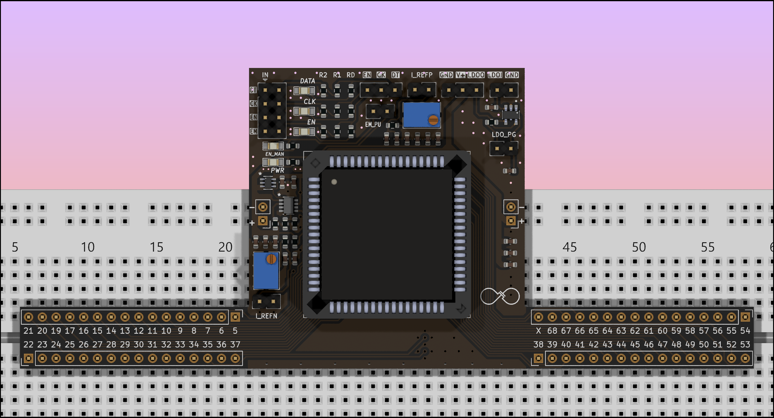
GND
GND
V+
V+

Slide 2
Apply 2.5V
GND
Lights up?
GND
GND
Check for 2.5V
Check for 2.5V

Slide 3
Check LED
3.3V Logic Test Signal
Check for 2.5V Logic Signal
GND
GND
GND

Slide 4
Jumper for Manual Enable
Apply 2.5V
GND
Check 2.5V present?
Check LED
GND
GND
Or apply 2.5V here
Or apply 2.5V here

Slide 5
CLK from DIO
Jumper to manually Enable the chip
(after programming)
DATA from DIO
Jumper to connect DATA to chip
Jumper to connect CLK to chip
Jumper to connect EM to chip

Slide 6
Check for 2.5V
(with appropriate load, see text)
>2.8V
GND
Connect
V+ to LDOO
(without chip, see text)
GND
GND

Slide 7
Notch in socket
Notch in chip package

Slide 8
Apply 2.5V
GND
Lights up?
GND
GND
Or apply 2.5V here
Or apply 2.5V here
Turn this potentiometer
+ -
Current Meter

Slide 9
Current Meter
+ -
Apply 2.5V
GND
Lights up?
Turn this potentiometer
GND
GND
Or apply 2.5V here
Or apply 2.5V here

Slide 11
Apply 2.5V
GND
Lights up?
GND
GND
Or apply 2.5V here
Or apply 2.5V here

Slide 13
CLK from DIO
DATA from DIO
Jumper to manually Enable the chip
(after programming)
Jumper to connect DATA to chip
Jumper to connect CLK to chip
Jumper to connect EM to chip

Slide 14
CLK from DIO
DATA from DIO
Jumper to manually Enable the chip
(after programming)
Jumper to connect DATA to chip
Jumper to connect CLK to chip
Jumper to connect EM to chip

Slide 15
CLK from DIO
DATA from DIO
Jumper to manually Enable the chip
(after programming)
Jumper to connect DATA to chip
Jumper to connect CLK to chip
Jumper to connect EM to chip

Slide 16
CLK from DIO
DATA from DIO
Jumper to manually Enable the chip
(after programming)
Jumper to connect DATA to chip
Jumper to connect CLK to chip
Jumper to connect EM to chip

